Slide 1

Vaccination Data Analysis and Visualization
This project analyze global vaccination data to identify trends in vaccination coverage, disease incidence, and vaccine effectiveness. The data will be cleaned and stored in a SQL database for efficient management. Using Power BI, interactive dashboards will be developed to visualize insights, enabling a deeper understanding of vaccination strategies and their impact on disease control. This approach will support data-driven decision-making and enhance public health outcomes.
by Saranya S

Slide 2
Project Objectives
1
Data Preparation Strategy
2
Database Infrastructure
3
Data Visualization Approach
SQL Database Setup: Create a robust relational database to efficiently store and manage vaccination records, enabling complex querying and data retrieval
Data Cleaning: Prepare and standardize global vaccination datasets, removing inconsistencies and ensuring data quality for accurate analysis
Power BI Integration: Connect cleaned data sources to Power BI for seamless data transformation and interactive visualization
4
Visualization Development
5
Analytical Insights Generation
Data Visualization in Power BI: Develop comprehensive, interactive dashboards that reveal vaccination trends, coverage rates, and regional variations
Exploratory Data Analysis (EDA): Uncover hidden patterns, correlations, and insights in vaccination data to support public health decision-making

Slide 3
Business Use Cases:
Public Health Strategy
Resource Allocation
Global Health Policy
Disease Prevention
Optimize vaccine distribution by forecasting demand and identifying regions with low coverage.
Generate evidence-based recommendations to guide national vaccination policy decisions.
Analyze vaccination impact to identify gaps and support strategies for emerging vaccine requirements.
Assess vaccination coverage across regions to prioritize targeted intervention efforts.

Slide 4
Data Sources:
Coverage Data
Incidence Rate
Data on vaccination rates by region, year, target populations, and doses administered.
Rates of disease occurrence by country and year.
Reported Cases
Vaccine Introduction
Number of disease cases reported for specific regions and years.
Information on whether a vaccine has been introduced in a country.
Vaccine Schedule Data
Details on the dose or round of vaccines in the immunization schedule.

Slide 5

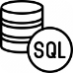
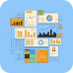
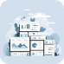
Technical Tags:
Python
SQL
Power BI
Analytics
Used for data extraction, cleaning, and initial analysis, Python's flexibility and powerful libraries are essential for processing large datasets.
SQL serves as the backbone for organizing and storing the structured data, ensuring data integrity and enabling efficient queries for analysis.
Power BI empowers the creation of interactive dashboards and visualizations, making the insights accessible and understandable to a wider audience.
The project leverages various analytical techniques, including EDA, correlation analysis, and trend analysis, to uncover valuable patterns and insights from the data.

Slide 6
Methodology:

Slide 7

Data Cleaning
Handling missing Data: Implement advanced imputation strategies by utilizing group-based aggregation methods, strategically filling missing values using statistically relevant related columns.
Date Consistency: Standardize data types through precise type casting, converting year and numerical columns to integer format to ensure data consistency and analytical accuracy.

Slide 8
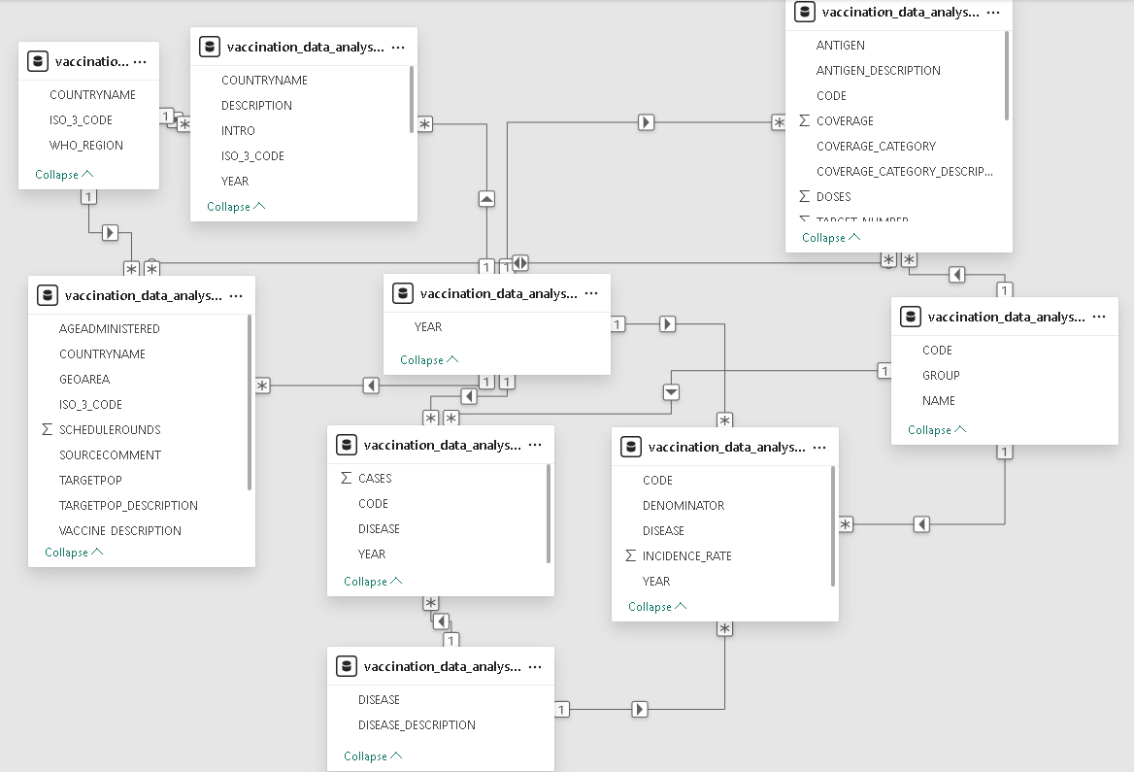
SQL Database Setup
Table Creation: Storing the structured and cleaned data in relational SQL tables, including vaccination data, disease incidence, and antigen details.
Data Normalization: Organize data into separate entities (e.g., vaccines, diseases, locations, and year periods) to minimize redundancy and enhance efficiency.
Ensuring Data Integrity: Implement primary and foreign key constraints to maintain referential integrity and data consistency.

Slide 9

Power BI Integration
Connect Power BI to the SQL database using its SQL connector to pull relevant tables for analysis. Set up scheduled refreshes for updated data.

Slide 10
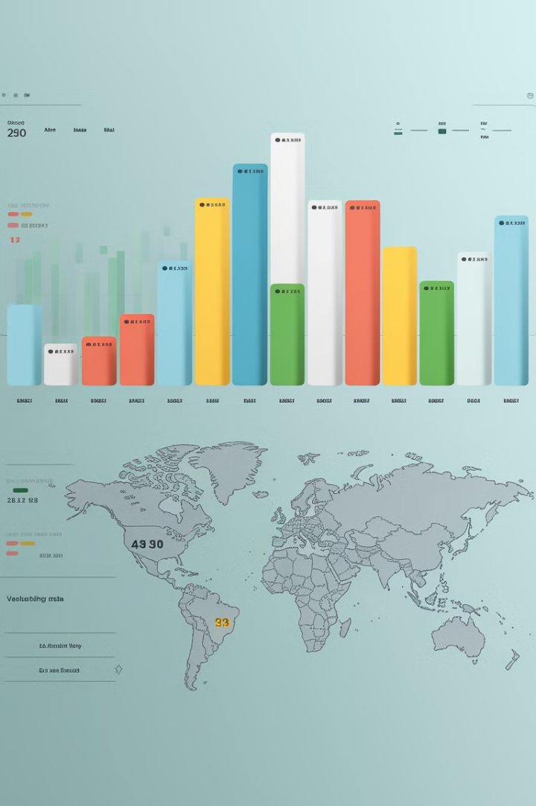
Data Visualization in Power BI
Creating Interactive Dashboards:
Using Power BI to create dynamic and visually engaging reports with filters and slicers for users to explore the vaccination data.
Visualize vaccination rates, disease incidence, and antigen coverage over time and across regions.
Displayed vaccination coverage and disease incidence by region.
Show trends in vaccination coverage, disease rates, and effectiveness over multiple years.
Correlate vaccination coverage and disease incidence across different countries or regions.

Slide 11

Exploratory Data Analysis (EDA)
Analyzed vaccination coverage trends, identifying regions with low coverage and exploring factors contributing to these disparities.
Analyzed disease trends, looking for patterns in disease outbreaks and evaluating the impact of vaccination programs on disease reduction.
Explored regional disparities in vaccination coverage and disease incidence, identifying areas where targeted interventions could have a significant impact.

Slide 12

Deliverables:
Python Scripts
SQL Database
We provide scripts for data extraction and cleaning, documenting the process and ensuring reproducibility of our analysis.
We deliver a structured and normalized SQL database containing the cleaned data, providing a foundation for further analysis and development.
Power BI Reports
Documentation
We present interactive reports and dashboards showcasing key insights, allowing stakeholders to explore the data and gain a deeper understanding of global vaccination trends.
We provide detailed documentation explaining the methodology, challenges faced, and solutions implemented, ensuring transparency and enabling others to build on our work.

Slide 13
Actionable Insights: Making a Difference
Prioritize Low-Coverage Regions
Support Vaccine Development
Our analysis identifies regions with low vaccination coverage, allowing for targeted efforts to improve immunization rates and reduce disease incidence in these areas.
By analyzing the effectiveness of existing vaccines and identifying diseases with high incidence rates, we can support research and development efforts for new and improved vaccines.
Optimize Resource Allocation
Inform Global Health Policies
Our analysis allows for efficient allocation of resources to regions with the greatest need, ensuring that limited resources are used effectively to maximize impact.
We provide data-driven recommendations for vaccination policies, supporting governments in making evidence-based decisions to improve global health outcomes.

Slide 14




The Impact of Vaccination: A Global Perspective
Reduced Disease Burden
1
Vaccination significantly reduces the burden of infectious diseases, saving lives and improving the overall health and well-being of individuals and communities.
Improved Health Outcomes
2
Vaccination contributes to improved health outcomes, reducing the incidence of preventable diseases and leading to a healthier and more productive society.
Stronger Immunity
3
Vaccination helps build a stronger immune system, protecting individuals from diseases and minimizing the risk of complications and long-term health issues.
Global Health Security
4
High vaccination coverage strengthens global health security, preventing the spread of infectious diseases across borders and contributing to a healthier world.

Slide 15

Conclusion: Building a Healthier Future
By analyzing global vaccination data, we gain invaluable insights into the effectiveness of vaccination programs and identify opportunities for improvement. This project empowers public health officials to make data-driven decisions, prioritize resources, and ultimately contribute to a healthier future for everyone.

